Slide 1
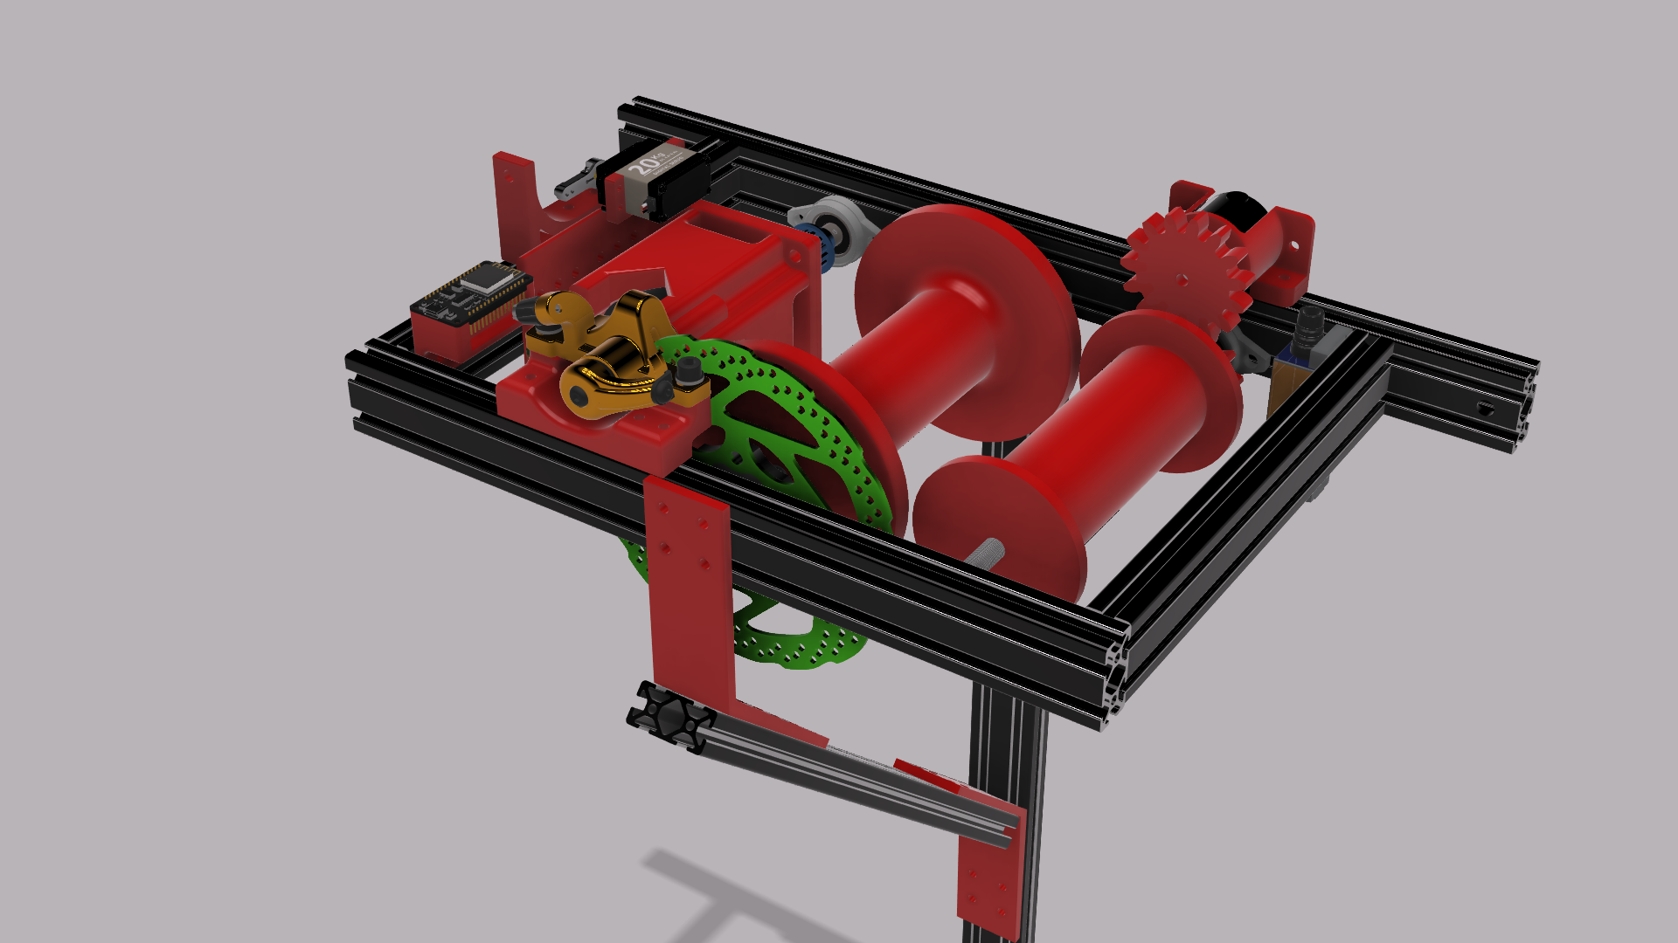

Automatic Winch for the Climbing Robot
First version by:
Luca Hardonk & Ruben Malacarne

Slide 2
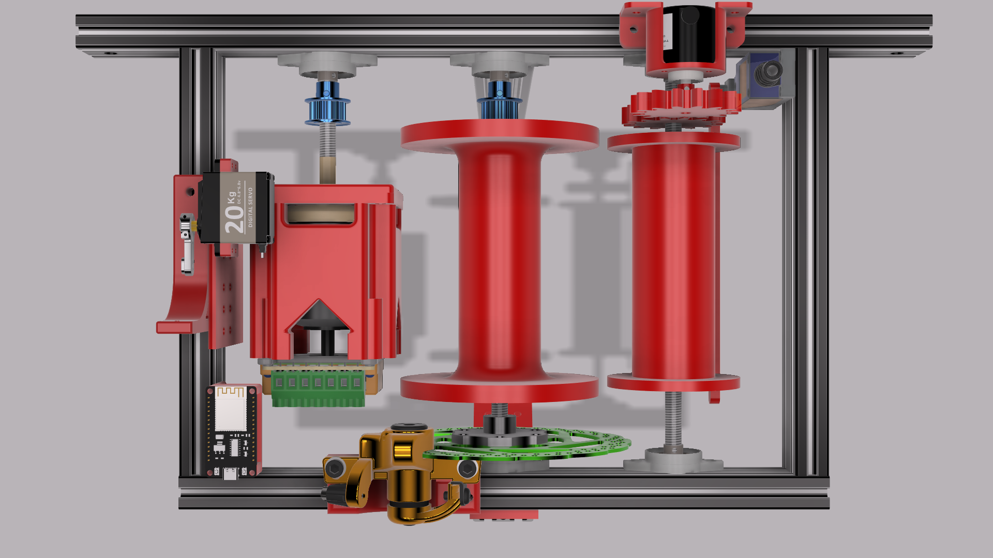
Rotary encoder system
Support winch
Stop switch
Motor with Odrive S1
Servo brake
Synchronous roller
Esp32 DevKit
Brake Caliper and Disk brake

